Slide 1








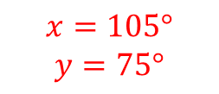
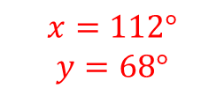
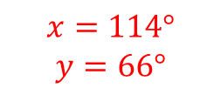
Subtopic G1.7 - Identify and calculate with sides and angles in special quadrilaterals.
LEARNING OUTCOME: To be able to identify and calculate angles in special quadrilaterals
Objectives:
Keywords:
Rhombus
Parallelogram
Trapezium
Kite
To be able to identify and calculate missing angles in rhombuses and parallelograms
To be able to identify and calculate missing angles in isosceles and right-angled trapeziums
To be able to identify and calculate missing angles in kites
Definition
Characteristics
A quadrilateral has to have four sides.
Rectangles, squares, trapeziums, kites, parallelograms and rhombuses are types of quadrilaterals.
The generic name for any four-sided shape.
Quadrilateral
Non - Examples
Examples
To be able to identify and calculate missing angles in rhombuses and parallelograms
Opposite angles in a parallelogram or rhombus are equal
 | Example 1 – I do… | Example 2 – We do… | Example 3 – You do…
Steps
1) Look for any opposite angles. 2) Look for any co-interior angles.

Slide 2
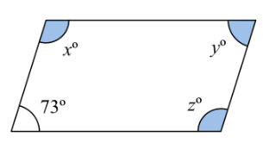
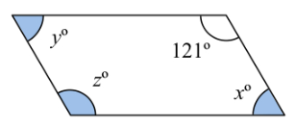
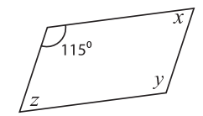









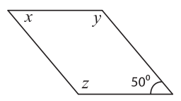
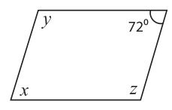
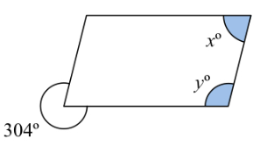











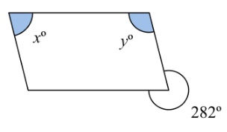







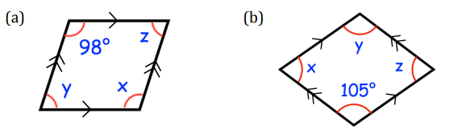











Independent Practice
Question 1. Find the missing angles in the parallelograms and rhombuses below:
a) | b) | c)
d) | e) | f)
g) | h) | i)
j) | k) | l)
‹#›
Notes:
https://www.mathworksheets4kids.com/parallelogram/angles/angles-diagonal-1.pdf

Slide 3














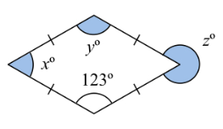
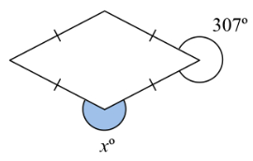










m) | n) | o)
p) | q) | r)
Question 2. Ralph draws a shape with two angles of 38° and two angles of 142°. Show that this could be a parallelogram.
Question 3. Jonny starts to draw a parallelogram. He draws and measures an angle of 85°. What would the size of the other three angles be?
‹#›

Slide 4
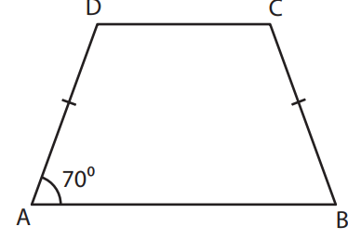
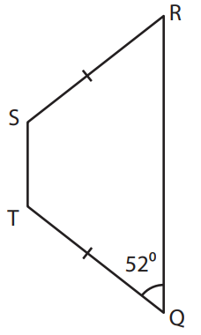


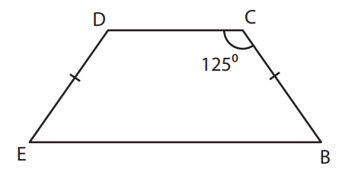





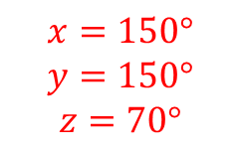
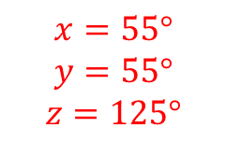
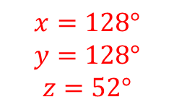
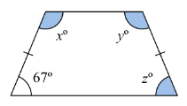
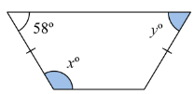
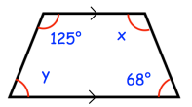
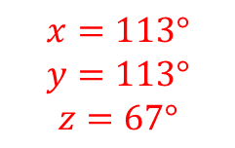
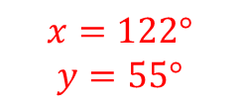
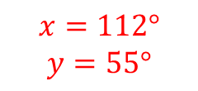
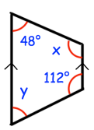
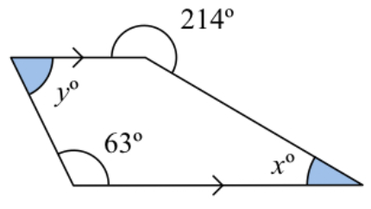
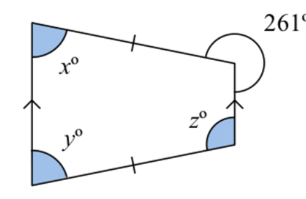
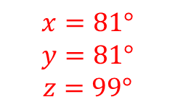
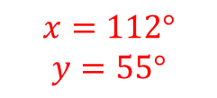
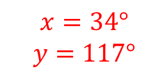
To be able to identify and calculate missing angles in isosceles trapeziums
Base angles in an isosceles trapezium are equal
Example 4 - I do…
Example 5 - We do…
Example 6 – You do…
Steps
1) Recall the correct angle facts needed. 2) Check for equal angles if it is an Isosceles trapezium. Check for co-interior angles. 3) Apply angle facts to find the other missing angles.
Independent Practice
Question 4. Calculate any missing angles in the trapeziums below. Be careful – not all of these are isosceles.
a) | b) | c)
d) | e) | f)
Notes:
https://www.mathworksheets4kids.com/parallelogram/angles/angles-diagonal-1.pdf

Slide 5
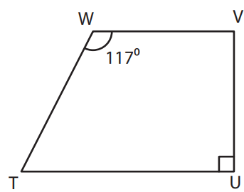
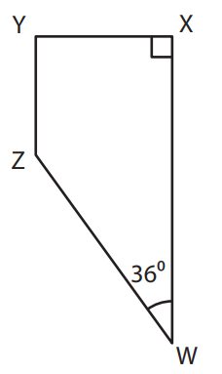
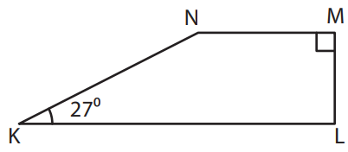





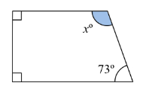
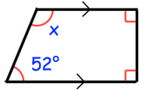














To be able to identify and calculate missing angles in right-angled trapeziums
Example 7 - I do…
Example 8 - We do…
Example 9 – You do…
Steps | Calculate the missing angle x. | Calculate the missing angle z. | Calculate the missing angle y.
1) Recall the correct angle fact. 2) Check for co-interior angles. 3) Subtract the sum of existing angles from the total.
Independent Practice
Question 5. Calculate the missing angles in the right-angled trapeziums below:
a) | b) | c)
d) | e) | f)
Notes:
https://www.mathworksheets4kids.com/parallelogram/angles/angles-diagonal-1.pdf

Slide 6
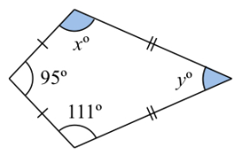
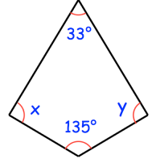
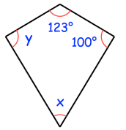
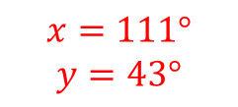
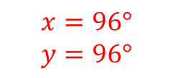
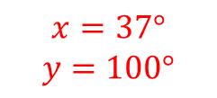
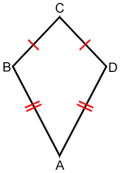









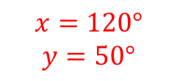
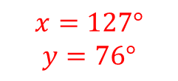
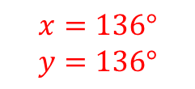








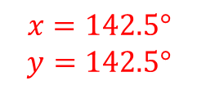
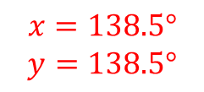
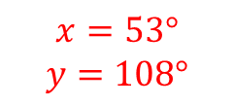
To be able to identify and calculate missing angles in kites.
In a kite, the two angles are equal where the unequal sides meet
Example 10 - I do…
Example 11 - We do…
Example 12 – You do…
Steps | Calculate the missing angle x. | Calculate the missing angle z. | Calculate the missing angle y.
1) Recall the correct angle fact. 2) Check for equal opposite angles. 3) Subtract the sum of existing angles from the total.
Independent Practice
Question 6. Calculate the missing angles in the kites below:
a) | b) | c)
d) | e) | f)

Slide 7

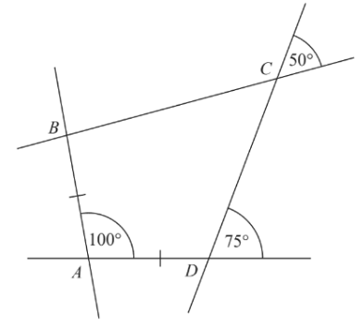



Question 7. The diagram ABCD shows a quadrilateral with its sides extended. Show that this quadrilateral is a kite.

Slide 8























Skills Check

